Slide 1
Make the hardest day
easier.
Your digital legacy, secured. GITTO turns "digital death admin" into a verified, trackable process that actually finishes.

Slide 2
Real Story
THE ABDULLAH STORY
85%
Have you ever thought about how to reclaim the digital assets of a loved one who has passed away?
of digital estates FAIL to transfer
Abdullah did. And had a nightmarish experience!
61%
LOCKED ACCOUNTS
ENDLESS LOOPS
Every platform demanded verification he couldn't provide
Automated responses, no human help available
encounter problems with death admin
NO OWNERSHIP
6.4 ORGANIZATIONS
7+ mo
Legal ownership meant nothing in the digital world
Average contacts per death. Abdullah contacted 12.
average to close accounts

Slide 3
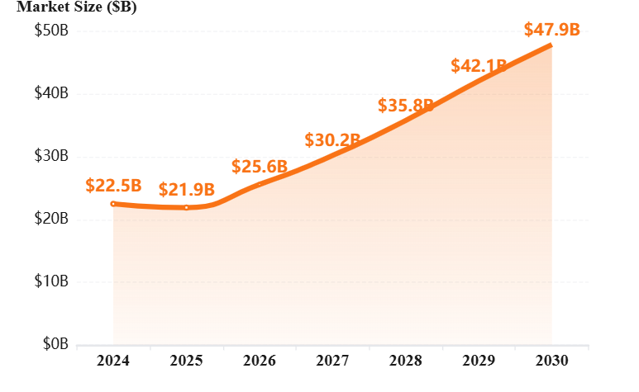
The Market
THE $25.6 BILLION CRISIS
Digital legacy market growth highlights a massive unmet need
Digital Legacy Market Growth
$25.6B
17.2%
CAGR Growth
2026 Market
Source: Business Research Company
85%
680K
Digital estates fail to transfer
Struggle with death admin annually
20 mo
1.2M
Average probate time
Receive post for dead yearly
The frustration of being on hold can be absolutely agonizing... I just wanted it all to be done.
— Marie Curie Research

Slide 4
The Core Problem
THE MFA DEADLOCK
Traditional wills transfer legal ownership—but not technical access
THE 2026 SCENARIO
THE SECURITY WALL
A father passes away. The heir has:
The Legal Will
2FA
Properly documented and notarized
Two-factor codes sent to a locked phone that no one can access
The Death Certificate
Official government documentation
Biometric
But CANNOT ACCESS:
Face ID and fingerprint locks that can't be bypassed
Coinbase
Gmail
Schwab
Liveness
The Insight: Wills transfer legal ownership—but modern security requires technical access.
AI-powered detection that fails when user is no longer alive
CAN'T BYPASS • PHONE LOCKED • CHECK FAILS

Slide 5
The Impact
THE REAL COST
The financial and emotional toll of digital estate failure
ZOMBIE
SUBSCRIPTIONS
CRYPTO
WALLETS
AI TRADING
BOTS
$140/mo
PERMANENTLY
LOST
UNSUPERVISED
EXECUTION
Netflix, cloud, SaaS draining the estate
Without seed phrases, assets vanish forever
Trading algorithms continue without oversight
Netflix, Spotify, Disney+
iCloud, Google Drive
$50K+
"Dad's bot lost $12K in 3 weeks. We couldn't stop it."
Average crypto lost
Slack, Notion, Adobe
24/7 automated trading
No password recovery
No customer support
No human oversight
$1,680/year lost
Potential massive losses
No legal recourse
Crypto recovered
Total per estate

Slide 6
The Solution
MEET GITTO
The first autonomous digital executor that bypasses the biometric wall
HOW GITTO WORKS
CORE CAPABILITIES
1
Active Agent + Blockchain
Stop Zombie Subscriptions
Monitors your status continuously through secure, decentralized verification
Instant cancellation
Monthly liveness checks
Unlock Crypto Wallets
2
Secure recovery
Detects When You're Gone
Autonomous detection through multi-factor liveness checks
Transfer Royalties
AI-powered detection
Income preserved
3
Orchestrates Handover
Save Digital Legacy
Transfers ACCESS—not ownership—to all digital assets
Memories secured
API-speed execution
VALUE PROPOSITION
Complete transfer in minutes, not months
GITTO bypasses the 'biometric wall' to transfer digital access—without compromising security while alive.

Slide 7
Decision Flow
THE DECISION TREE
Two paths diverge when someone passes away
SOMEONE PASSES AWAY
What happens to their digital assets?
TRADITIONAL PATH
GITTO PATH
Legal Will + Certificate
Active Agent
Heir has documentation
Continuous monitoring
MFA DEADLOCK
AUTONOMOUS
2FA codes unreachable
Blockchain verification
Biometric lock fails
Multi-factor liveness
Liveness check fails
Secure key release
RESULT
RESULT
20 months
12 minutes
No digital access
Full access granted
$ LOST
$ SAVED

Slide 8
Competitive Advantage
BETTER THAN ALTERNATIVES
GITTO is the only solution that orchestrates the entire digital estate
PASSWORD
MANAGERS
PLATFORM
LEGACY
TRADITIONAL
LEGAL
The Problem
The Problem
The Problem
Passive systems. Master password dies with you—unless written down (security risk).
Siloed solutions. Google only unlocks Google. No cross-platform orchestration.
Lawyers operate on "paper speed" (months). Cannot bypass 2FA barriers.
No autonomous detection
67% assets uncovered
Months to years
Manual sharing required
Platform-specific only
Cannot bypass 2FA
No financial access
Can't stop subscriptions
No technical access
LastPass, 1Password, Bitwarden
Google, Apple, Facebook
Estate attorneys, probate courts
GITTO: Active agent + cross-platform orchestration + API speed

Slide 9
The Technology
TECHNOLOGY STACK
Enterprise-grade security with empathetic user experience
SECURITY ARCHITECTURE
USER JOURNEY
Client-Side Encryption
G
The Grantor
Zero-knowledge—only you control your data
Asset owner (living)
Sinch Flash Call Flow
Monthly: Liveness check
Global verification through secure flash calls
Quarterly: Update inventory
Blockchain Verification
B
The Beneficiary
Immutable proof of status and ownership
Heir (after death)
Multi-Factor Liveness
Uses Once
Biometric + behavioral + document verification
At the most stressful moment
→ UX must be flawless
BANK INTEGRATION
Sinch Mailjet sends verified death notifications to bank fraud departments, enabling instant credit card freezing.

Slide 10
Business Model
B2B2C MODEL
Insurance providers and law firms pay; users benefit
WHO PAYS
WHO USES
Life Insurance Providers
G
The Grantor
Allianz, Prudential, MetLife
Asset owner (living)
Bundle GITTO as bereavement support—like roadside assistance
Monthly: Liveness check
Quarterly: Update inventory
Estate Law Firms
Boutique & HNW practices
B
The Beneficiary
Offer to crypto clients as value-added service
Heir (after death)
Uses Once
At the most stressful moment
→ UX must be flawless
REVENUE MODEL
$X
$Y/mo
Per-Policy Fee
Law Firm License
VALUE EXCHANGE
bundled with insurance
per attorney seat
Partners pay for retention. Users get peace of mind. Heirs get seamless access.

Slide 11
Partnership Value
WHY INSURERS CARE
Claims-time is a customer acquisition moment
THE BUSINESS CASE
BRAND PROTECTION
57%
33%
When someone dies, the insurer is in the emotional blast radius . If the experience is cold or messy, the brand gets blamed.
Choose Based on Support
Felt Under-Supported
select insurers by quality
worse for Gen Z = churn
COST SAVINGS
Reducing churn by 2% per year = cutting costs by 10%+
76%
2%
THE HEIR = NEXT CUSTOMER
No Digital Asset Plan
Retention Impact
The person who died is gone, but spouse/children become:
avoid until disaster hits
= 10%+ cost cut
New Policy Shoppers
Decision Makers
"Amazing" vs "Never again"
BUNDLE AS DEFAULT
Like roadside assistance—people don't buy because they love admin, they accept it because it's there when disaster hits.
When death happens, the family suffers. That's exactly when an insurer can bundle GITTO as default support.

Slide 12
Execution Plan
12-MONTH ROADMAP
Ambitious plan demonstrating deep industry knowledge
Q1
Q2
Q3
Q4
SECURITY & COMPLIANCE
BETA & PARTNERSHIPS
SCALE & ENTERPRISE
GLOBAL EXPANSION
Closed Beta
Public Launch
EU Launch
SOC 2 Type II
100 users, 10 law firms
General availability
GDPR-compliant rollout
Complete audit & certification
Ledger Partnership
Allianz Pilot
Multi-Language
Zero-Knowledge
Integration in wallet onboarding
Major insurer partnership
12 languages supported
Client-side encryption only
Bank APIs
DeFi Integration
Regulatory
GDPR/CCPA
Direct fraud dept integration
Aave, Compound, Uniswap
UK FCA, Singapore MAS
Global privacy compliance
Mobile Apps
AI Enhancement
Series A
Bug Bounty
iOS & Android launch
Predictive asset detection
$10M funding round
HackerOne program launch
FOUNDATION
VALIDATION
GROWTH
DOMINATION

